Slide 1
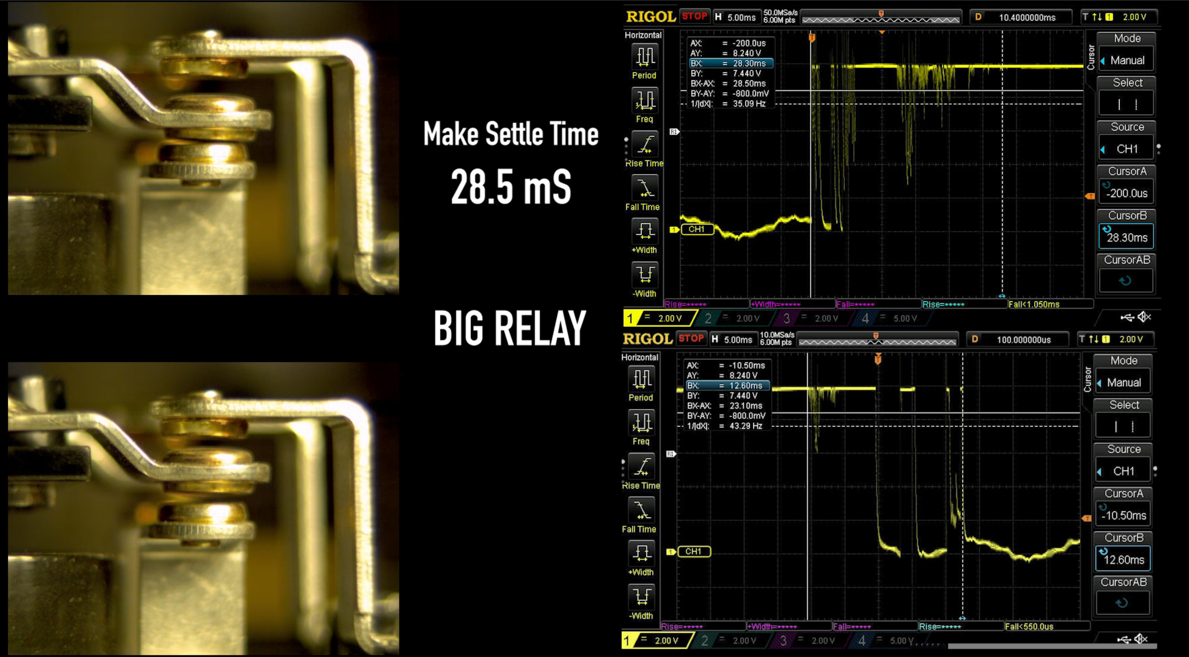

Slide 2
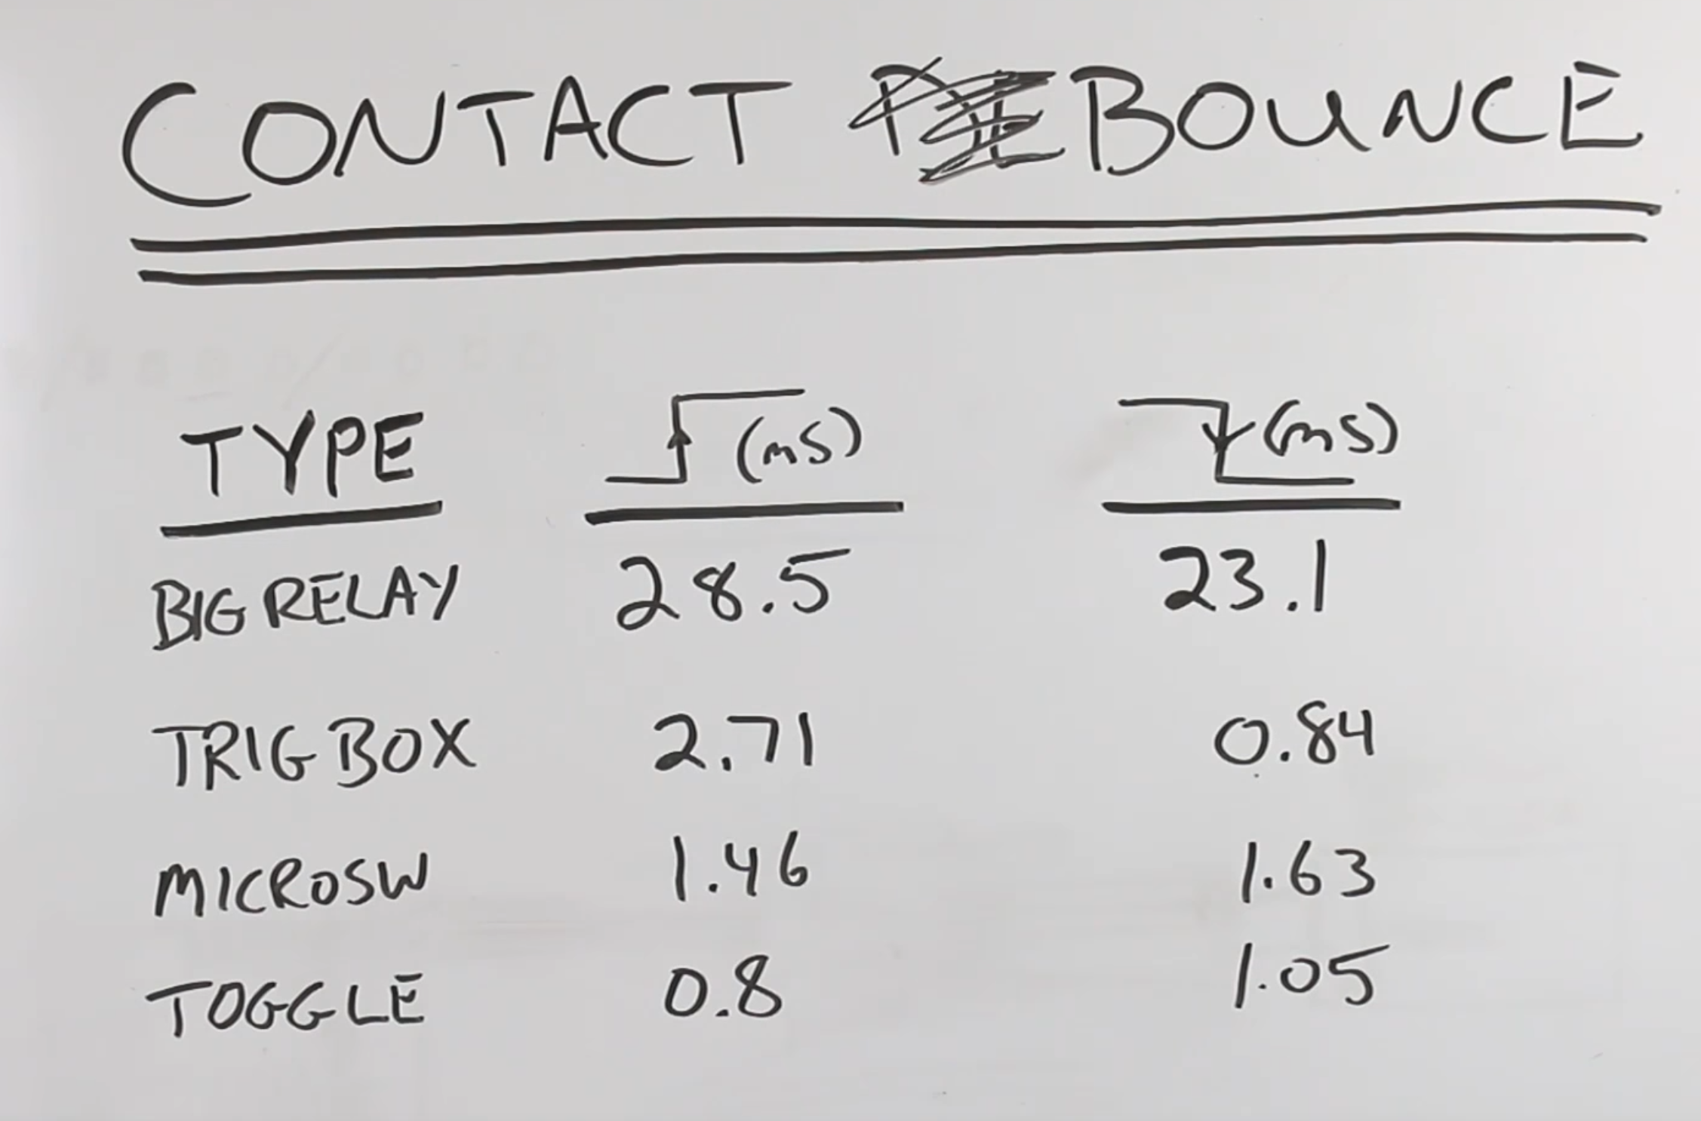
Switch Activated
Open to Close
Switch Deactivated
Close to Open
Notes:
https://youtu.be/jI-rC2FCKo4

Slide 3
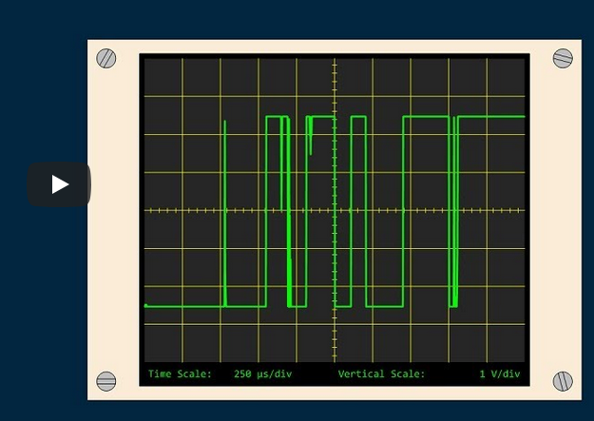

Slide 4
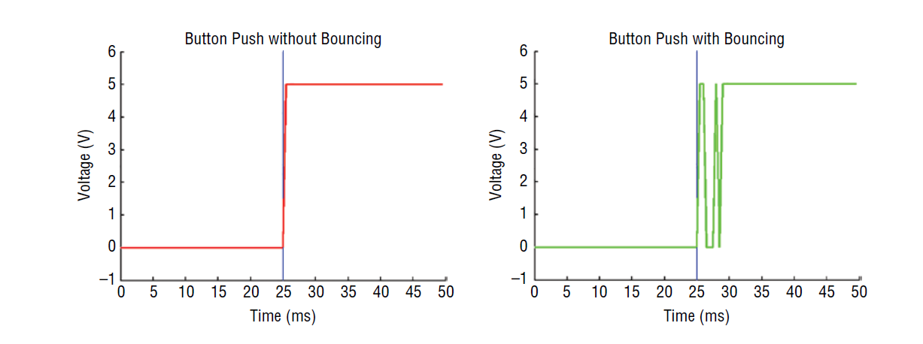
State Change Detected
State Change Check
Bouncing
Debouncing Window (12ms)
5 -
5 -
Steady High
2.5 -
Voltage (V)
2.5 -
Voltage (V)
Steady Low
0 -
0 -
0
5
10
15
20
25
30
35
40
45
50
0
5
10
15
20
25
30
35
40
45
50
Time (ms)
Time (ms)
35
40
45
50
55
60
65

Slide 5
Bouncing
Debouncing Window (12ms)
State Change Check
5 -
5 -
Steady High
State Change Detected
2.5 -
Voltage (V)
2.5 -
Voltage (V)
Steady Low
0 -
0 -
0
5
10
15
20
25
30
35
40
45
50
0
5
10
15
20
25
30
35
40
45
50
Time (ms)
Time (ms)
35
40
45
50
55
60
65

Slide 6
Robust: two input reads w/state verification
Common: Single input read with ignore window
State Change Check
Verify value
Debouncing Window (12ms)
State Change Check
We don’t verify the value here, but once a state change has been detected, we do still ignore changes on this digital input pin for the debouncing window time
Debouncing Window (12ms)
5 -
5 -
State Change Detected
This state change could be intentional or due to electrical noise, so store value, which we will verify at end of debouncing window
State Change Detected
Assume that this state change is not accidental.
2.5 -
2.5 -
Voltage (V)
Voltage (V)
0 -
0 -
0
5
10
15
20
25
30
35
40
45
50
0
5
10
15
20
25
30
35
40
45
50
Time (ms)
Time (ms)

Slide 7
